Slide 1

HOTEL MANAGEMENT SYSTEM

Slide 2
TEAM Members
Akash
RIYASKHAN.A
HELEN KIRUBA.M
SANTHOSHI MUNGI

Slide 3


PROJECT INTORDUCTION
Hotel Management System is a web-based application that allows the hotel manager to handle all hotel activities online. Interactive GUI and the ability to manage various hotel bookings and rooms make this system very flexible and convenient.
Customers can view and book room online. Admin has the power of either approving or disapproving the customer’s booking request.

Slide 4
Module
Admin
Customer
Place
Hotel
Room
Facilities
Booking

Slide 5




software
Back-end
front-end
Spring-Boot
Spring Core
JPA
Rest API
Angular
Node js
Visual studio code
TypeScript
database
My-SQL

Slide 6
hardware requriements
windows 10 or abouve
ram: 4gb above

Slide 7
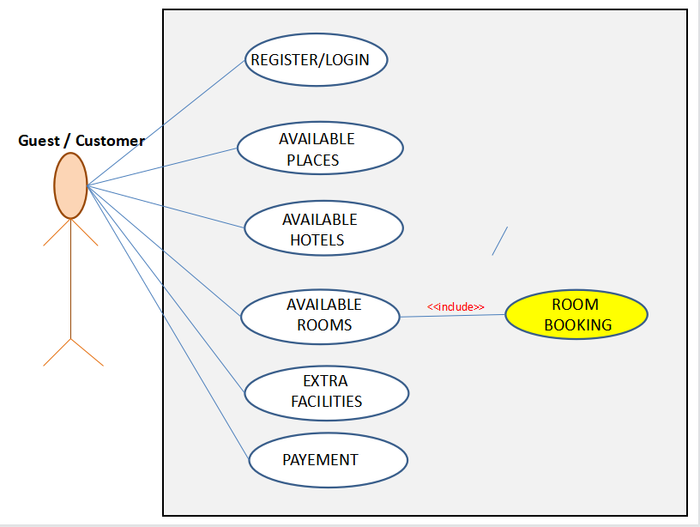
hotel management use-case

Slide 8
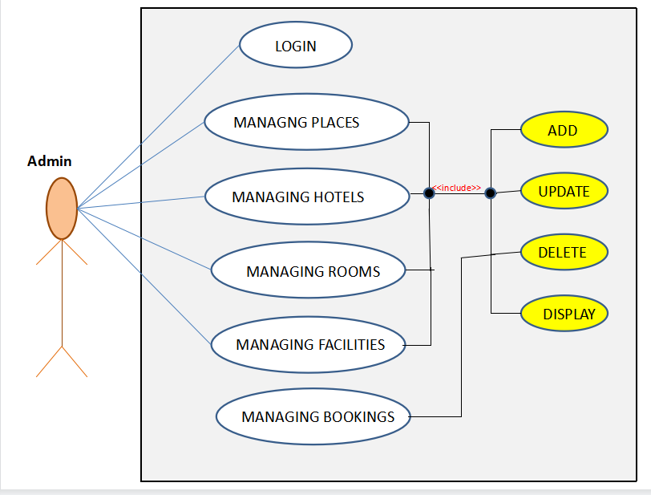
hotel management use-case

Slide 9
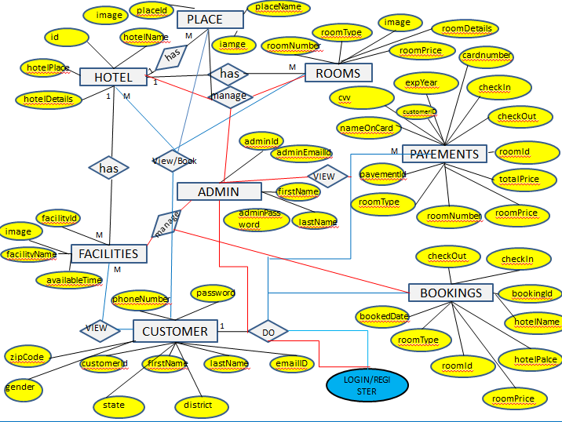
HOTEL MANAGEMENT ER-DIAGRAM

Slide 10
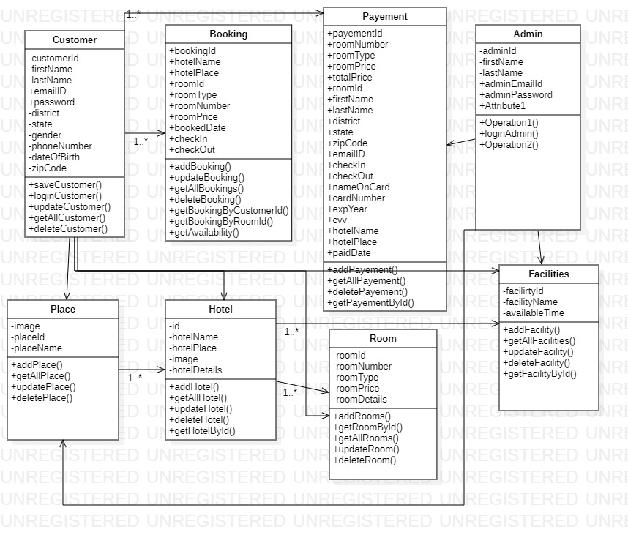
class diagram

Slide 11
OUTPUT

Slide 12
ADMIN

Slide 13


Slide 14
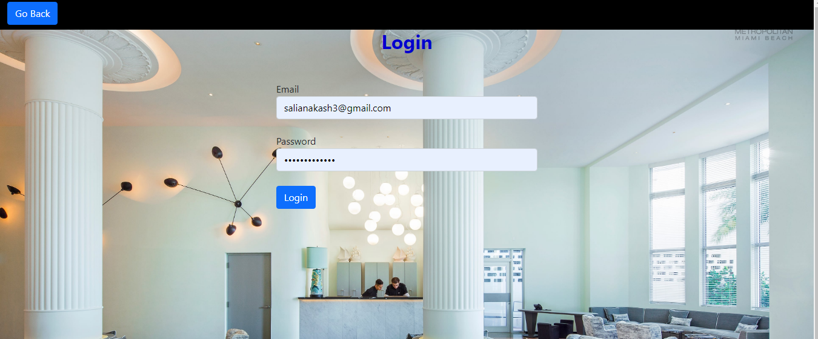

Slide 15
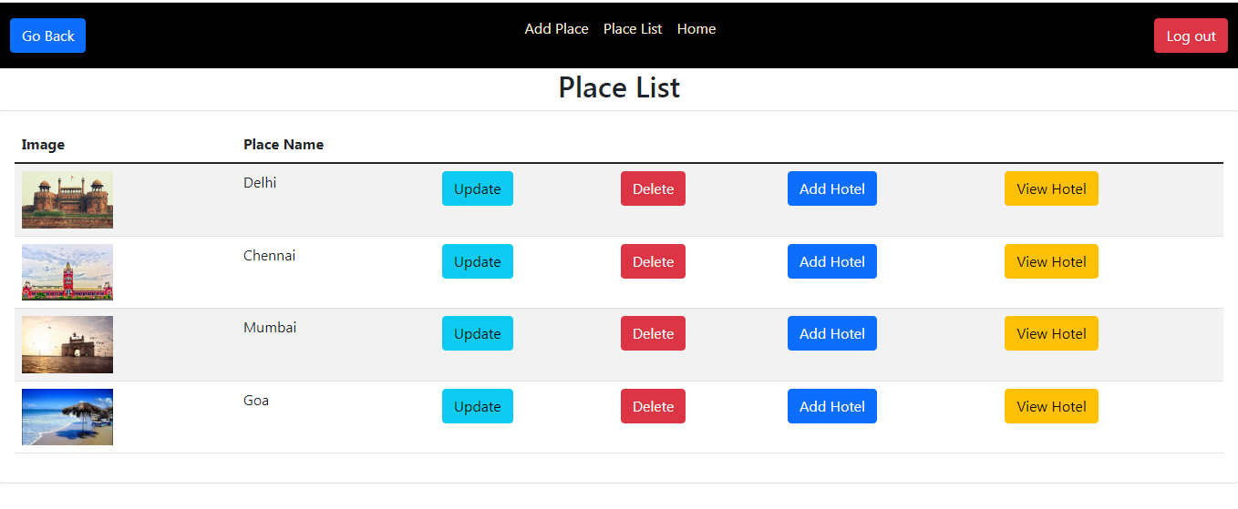

Slide 16
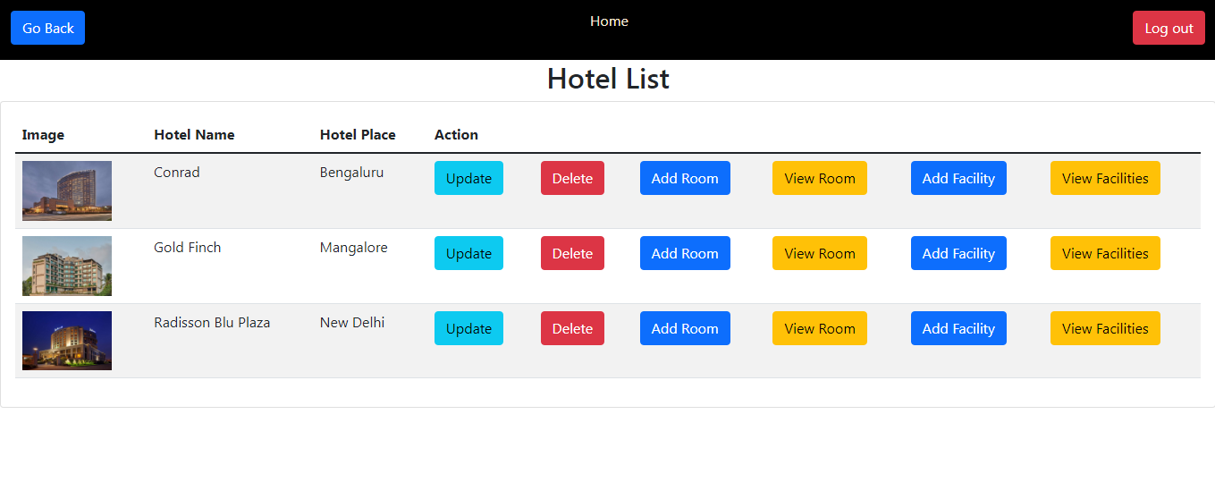

Slide 17
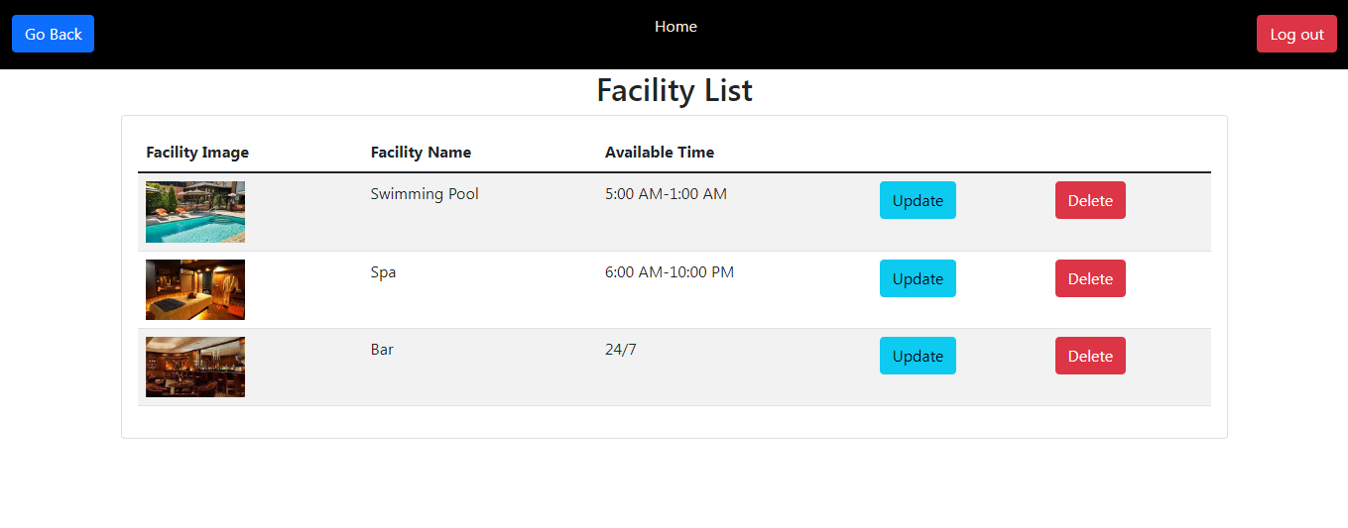

Slide 18
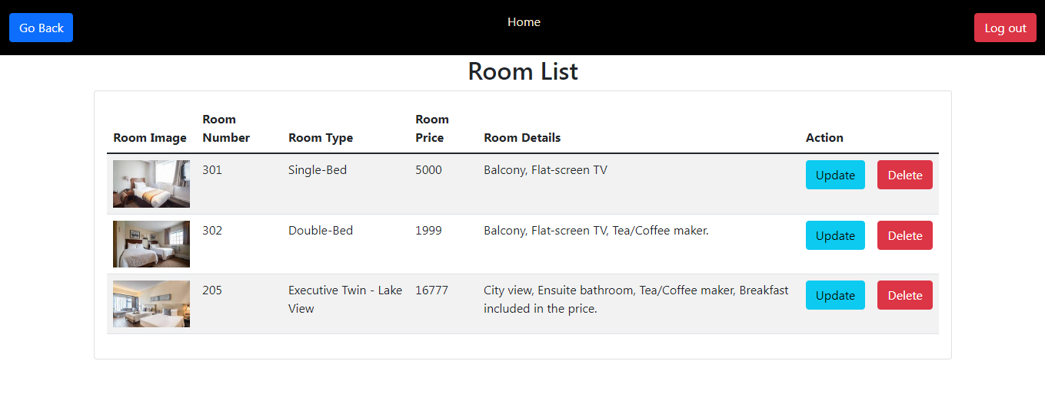

Slide 19
Conclusion
A Hotel management system is a computerized management system.
This system keeps the records of hardware assets besides software of this organization.
This system is completely secure since every user is provided with a user ID and Password so there is no chance of any unauthorized access. Online Payment, Booking,
So, using this system will help in reducing the labor and provide more facility for Customer to like Hotel and visit again and again.

Slide 20
CUSTOMER

Slide 22
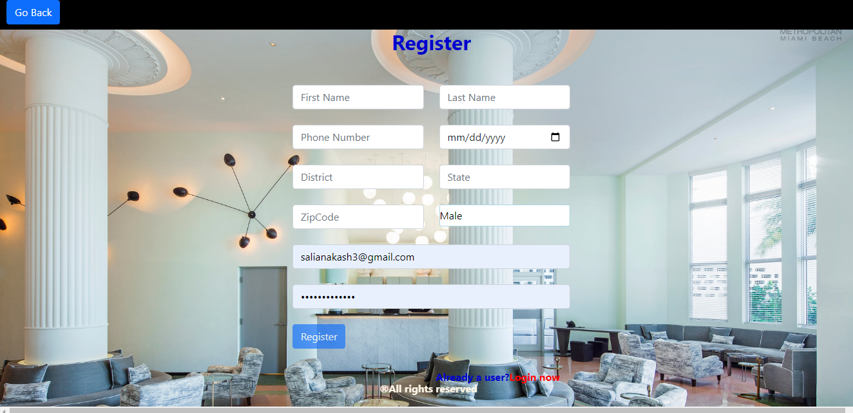

Slide 24
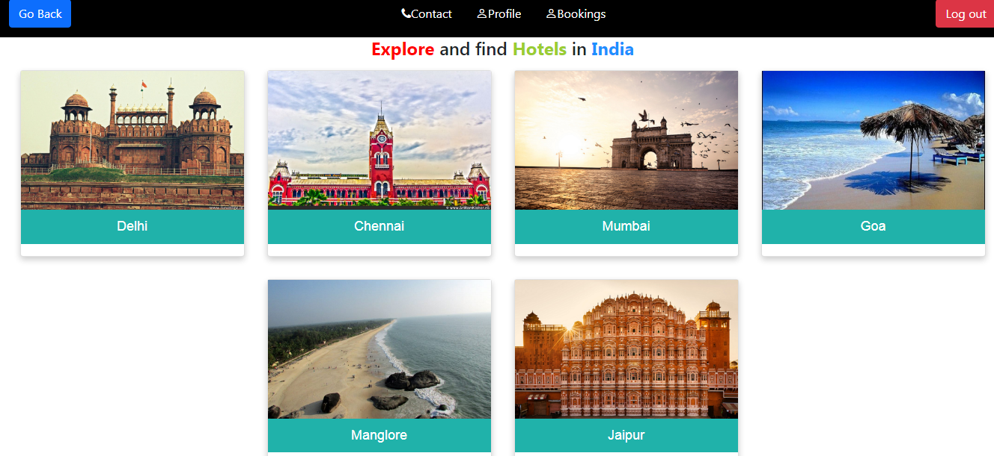

Slide 25
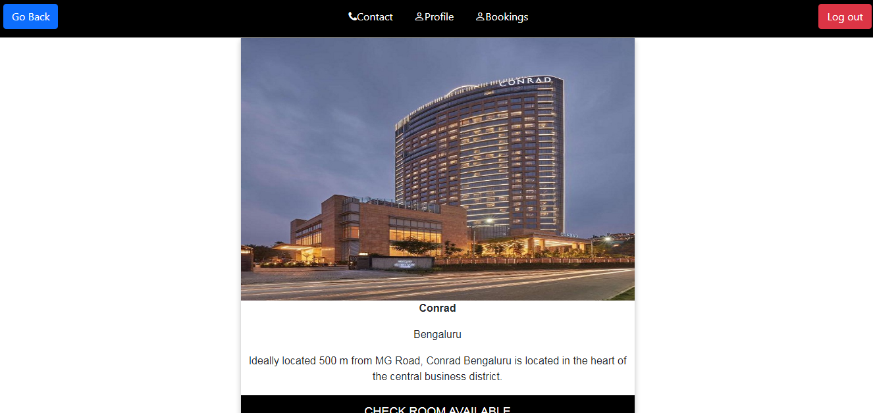

Slide 26
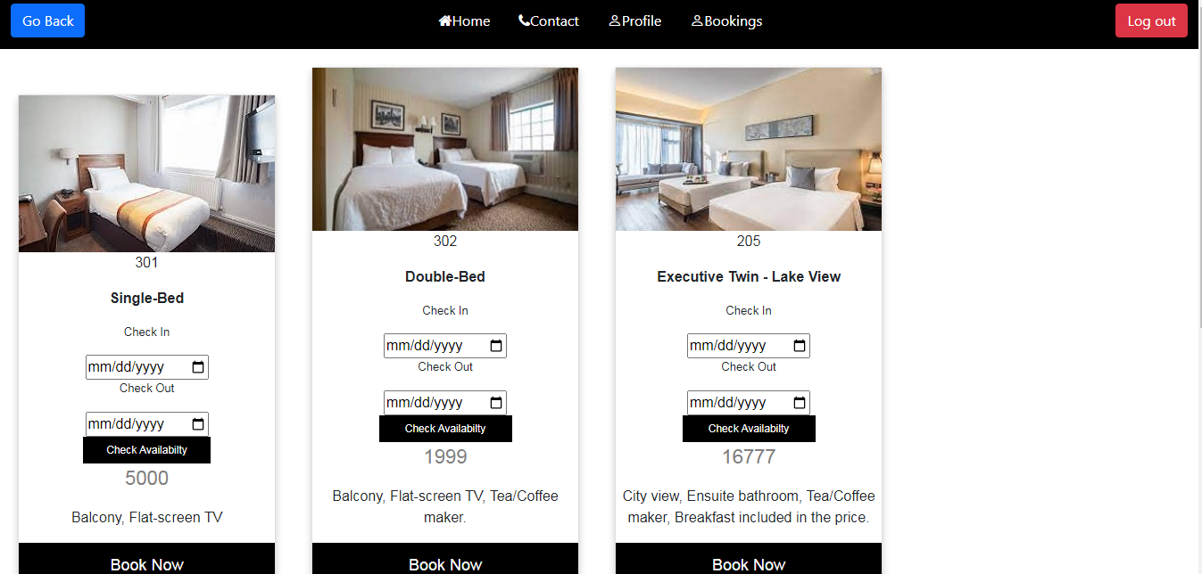

Slide 27
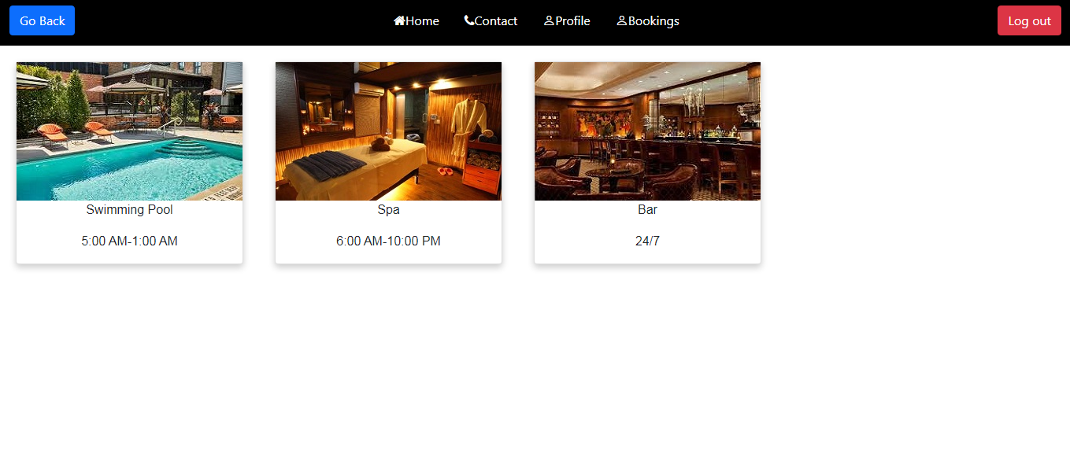

Slide 28
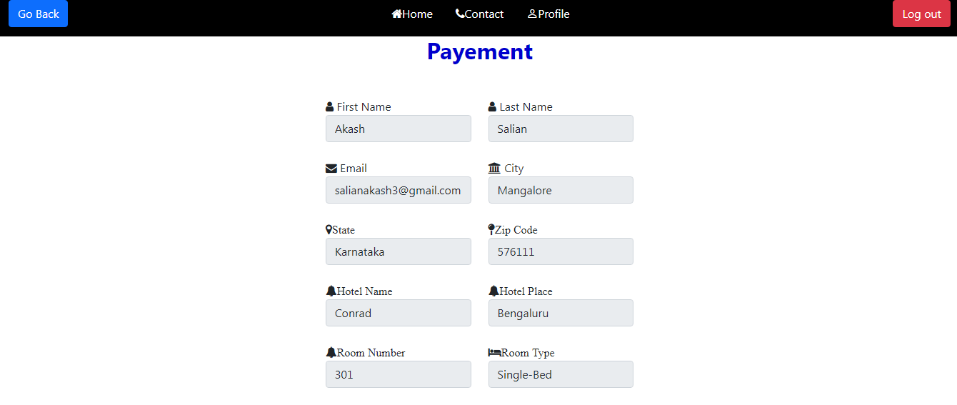

Slide 29
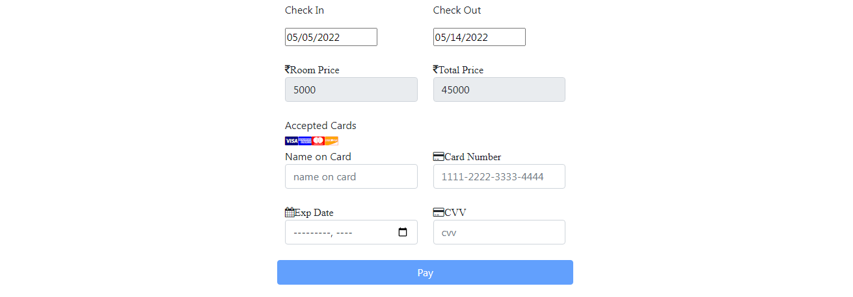

Slide 30
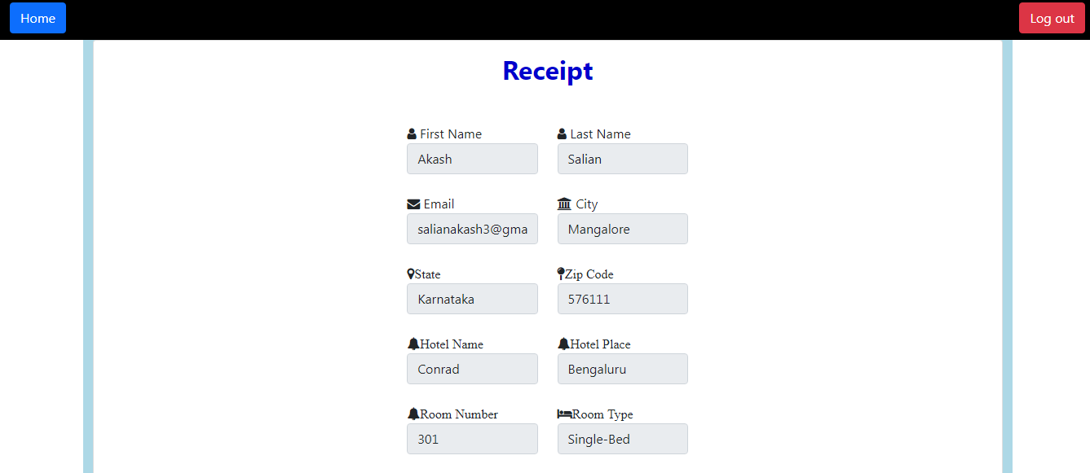

Slide 31
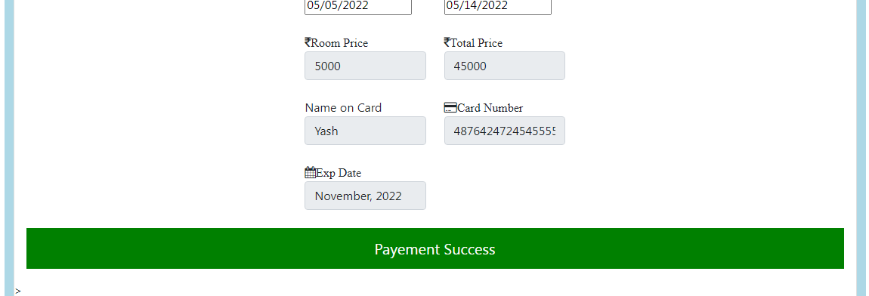

Slide 32
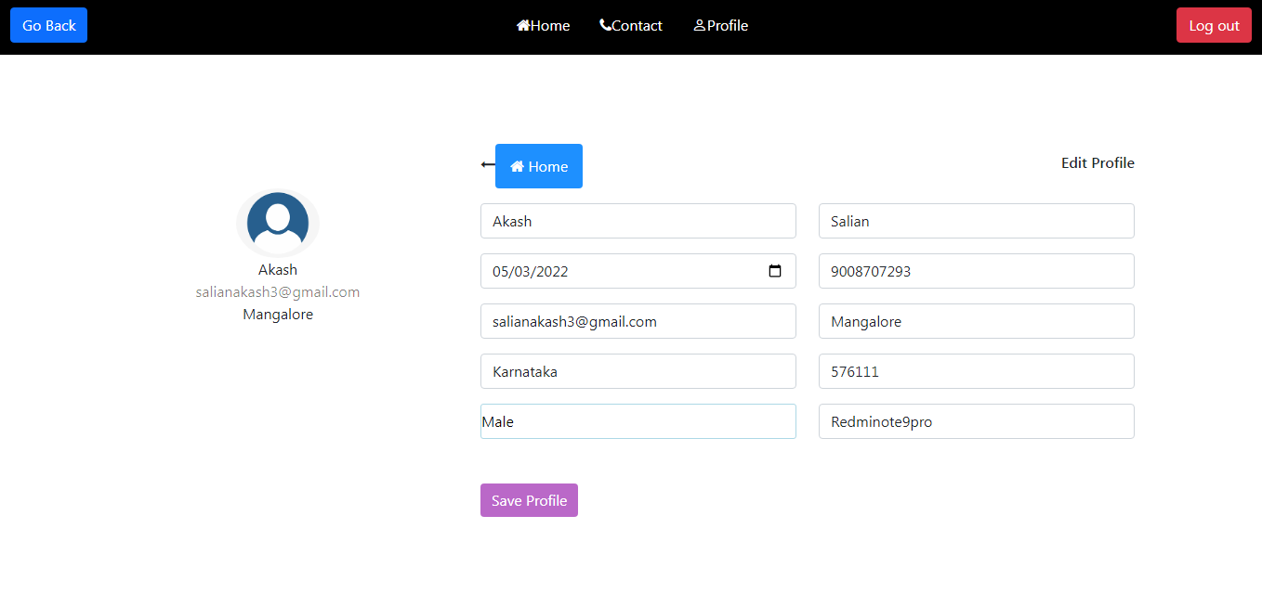

Slide 33
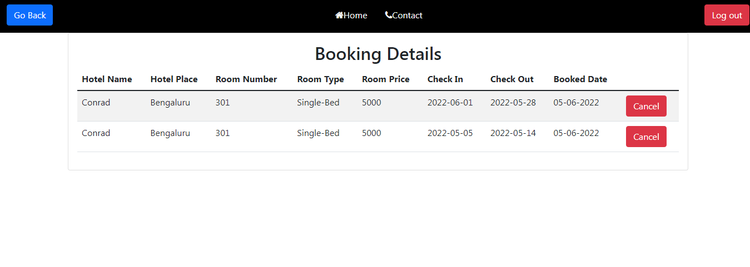

Slide 34
Reference
google
youtube

Slide 35
thank you!

